Slide 1
Accurate, Detailed, and Automatic Tree Modelling from Point Clouds
Shenglan Du
Mentor: Liangliang Nan
3D Geoinformation Group

Slide 2
CONTENT
Introduction
Related Work
Methodology
Experiment Results
Conclusion & Future Work

Slide 3
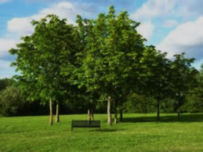
1. Introduction

Slide 4
1.1 Motivation
Why do we want to model trees?

Slide 5
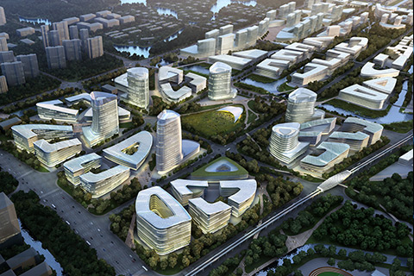
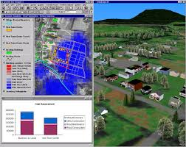
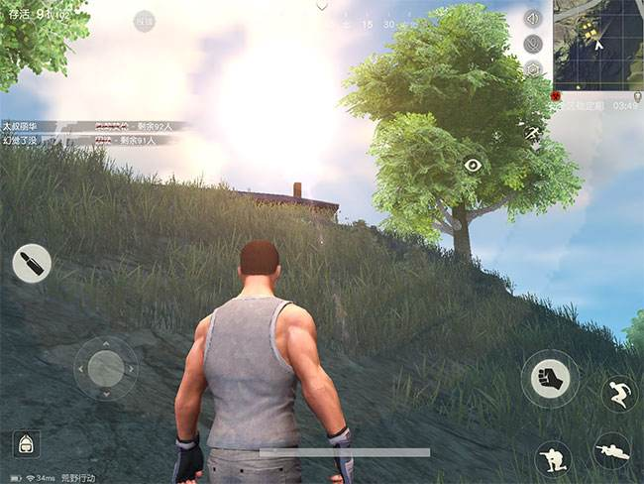
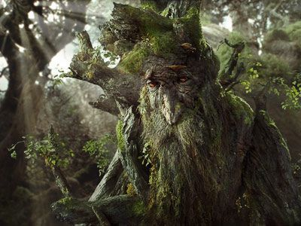
1.1 Motivation
Urban landscape design
Environment modelling.
Game visualization
Movie special effect

Slide 6
1.1 Motivation
Why do we want accurate tree models?

Slide 7
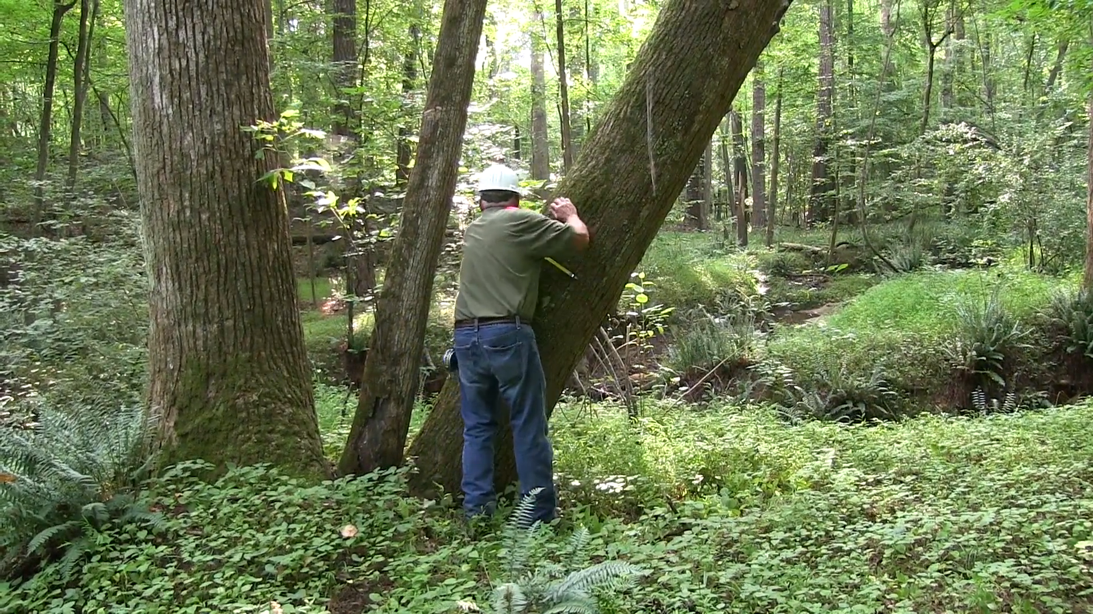
1.1 Motivation

Slide 8
1.2 Research Objective
3D tree modeling from point clouds
Accurate (geometrically correct)
Detailed (topologically faithful)
Automatic

Slide 9
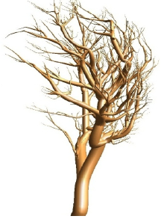
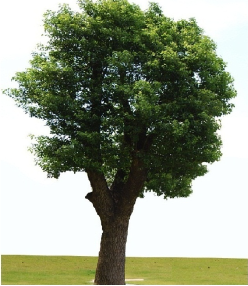

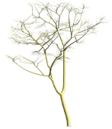
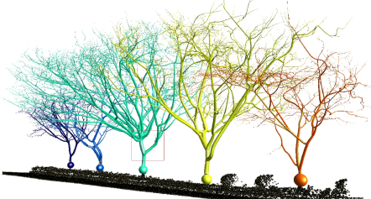
1.3 Research Scope
Focus on branch reconstruction
Focus on individual tree reconstruction

Slide 10
2. Related Work

Slide 11
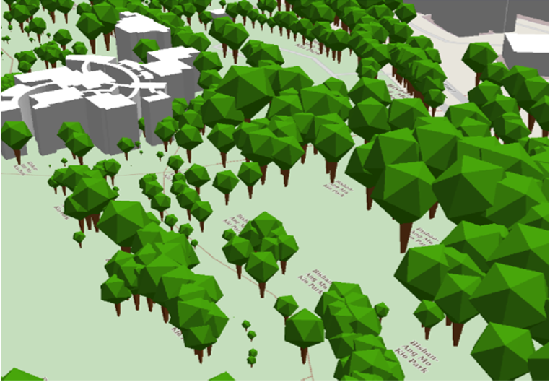
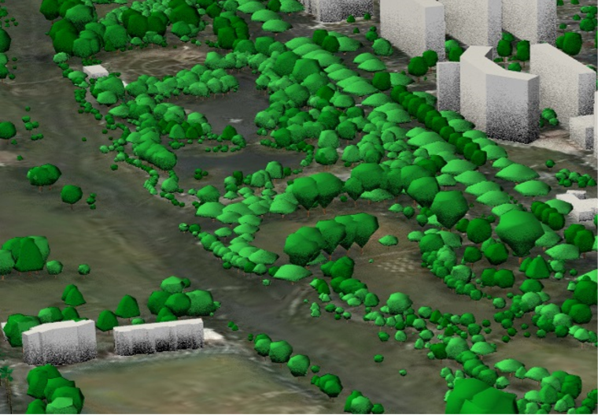
2.1 Modelling “icon” trees
Modelling 3D trees for CityGML Singapore (Soon et al. 2017)
LOD1 LOD2
Can model trees on a large region
Tree model is not accurate or detailed

Slide 12
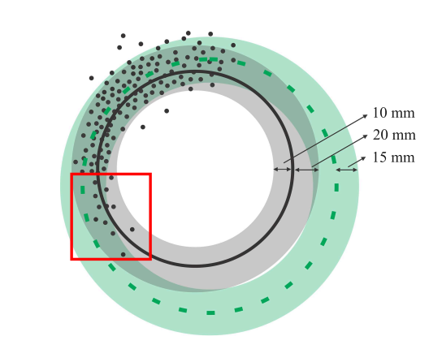
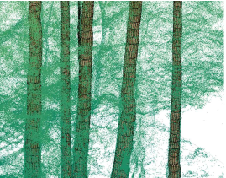
2.2 Cylinder-fitting approach
Automatic trunk reconstruction (Wang et al. 2016)
fitting process reconstructed trunk
Can model the trunk accurately
Doesn’t consider other small tree branches

Slide 13
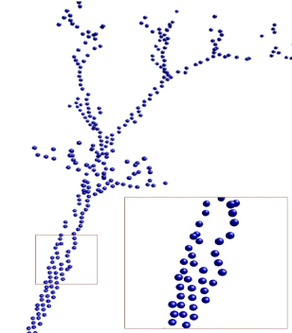
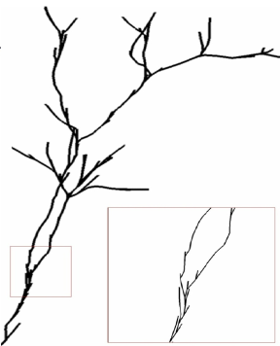
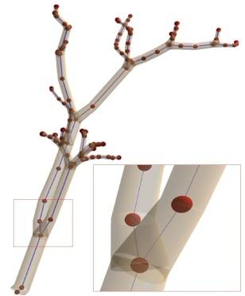
2.3 Skeleton-based approach
Automatic reconstruction of tree skeleton (Livny et al. 2010)
point clouds skeleton tree branches
Can model the complicated skeletal structure of the tree
Doesn’t fit enough to the input points

Slide 14
3. Methodology

Slide 15
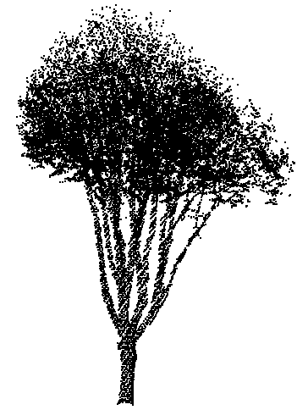
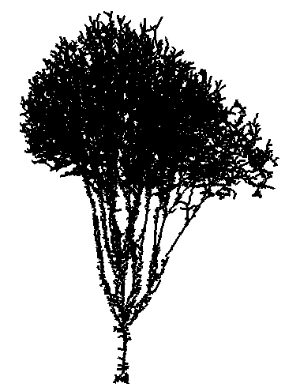
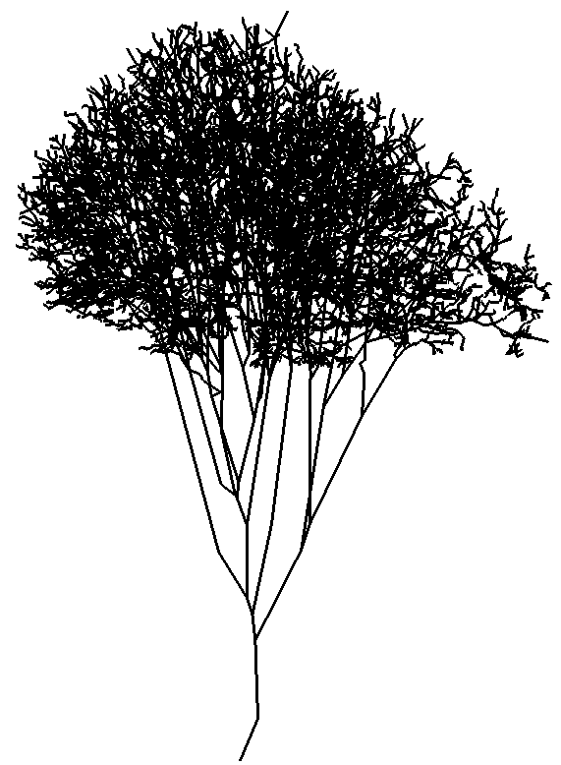
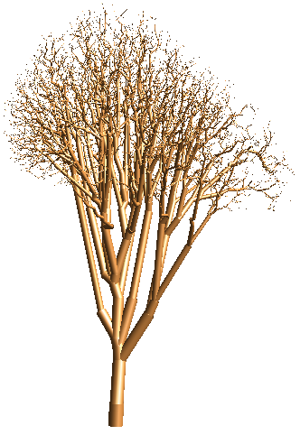
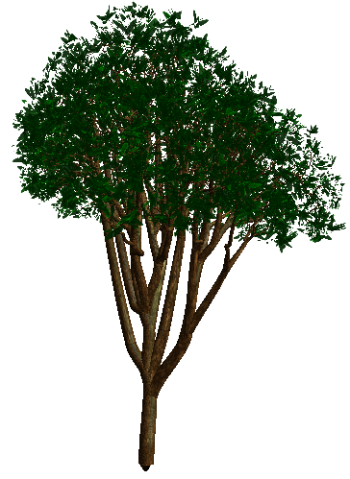
3. Methodology Overview
Add realism
Point cloud
Skeleton Initialization
Skeleton Simplification
Branch Fitting
Fine Model

Slide 16
3. Methodology Overview
Add realism
Point cloud
Skeleton Initialization
Skeleton Simplification
Branch Fitting
Fine Model

Slide 17
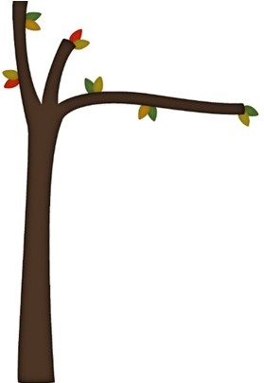
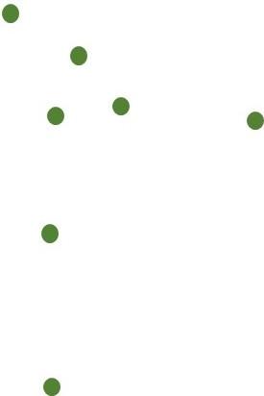
3.1 Skeleton Initialization
We obtain initial tree skeleton from the minimum spanning tree
Read input points
Real tree
Point cloud

Slide 18
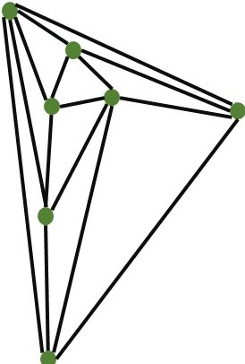
3.1 Skeleton Initialization
We obtain initial tree skeleton from the minimum spanning tree
Construct Delaunay triangulation
Point cloud
Delaunay triangulation

Slide 19
3.1 Skeleton Initialization
We obtain initial tree skeleton from the minimum spanning tree
It provides a very initial graph
It completes missing parts of data

Slide 20
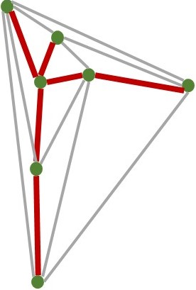
3.1 Skeleton Initialization
We obtain initial tree skeleton from the minimum spanning tree
Compute minimum spanning tree from shortest path
root
Delaunay triangulation
Minimum spanning tree

Slide 21
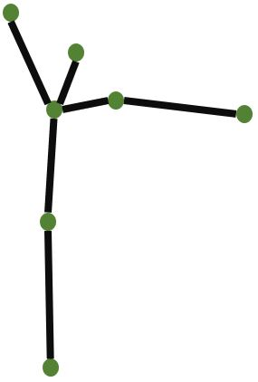
3.1 Skeleton Initialization
We obtain initial tree skeleton from the minimum spanning tree
Obtain the initial skeleton
Minimum spanning tree
Initial skeleton

Slide 22
3.1 Skeleton Initialization
An extracted initial skeleton

Slide 23
3. Methodology Overview
Add realism
Point cloud
Skeleton Initialization
Skeleton Simplification
Branch Fitting
Fine Model

Slide 24
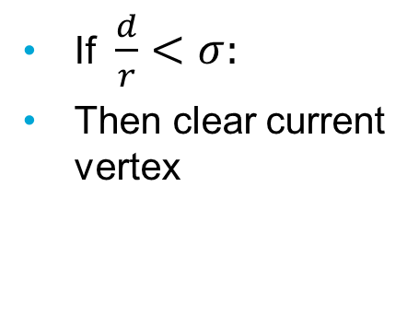
3.2 Skeleton Simplification
Iterative simplification
Single-child vertex simplification
Child
Child
If $\frac{d}{r}<σ:$
Then clear current vertex
d
Current
r
Parent
Parent

Slide 25
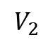

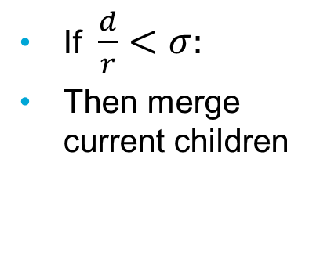
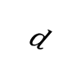
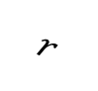
3.2 Skeleton Simplification
Iterative simplification
Multiple-children vertex simplification
$$r$$
If $\frac{d}{r}<σ:$
Then merge current children
$$V_{1}$$
$$V_{2}$$
New vertex
$$d$$
Current
Current

Slide 26
3.2 Skeleton Simplification
Simplified Skeleton

Slide 27
3. Methodology Overview
Add realism
Point cloud
Skeleton Initialization
Skeleton Simplification
Branch Fitting
Fine Model

Slide 28
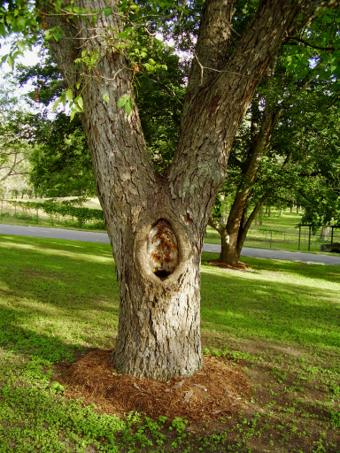
3.3 Branch fitting
Fit cylinders to approximate the branch geometry

Slide 29
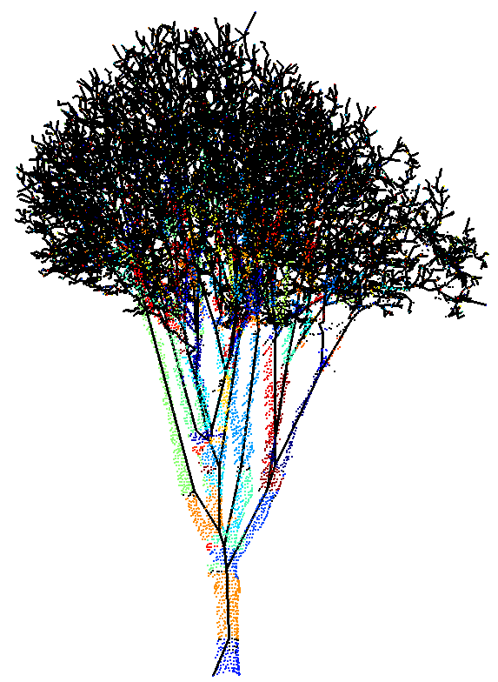
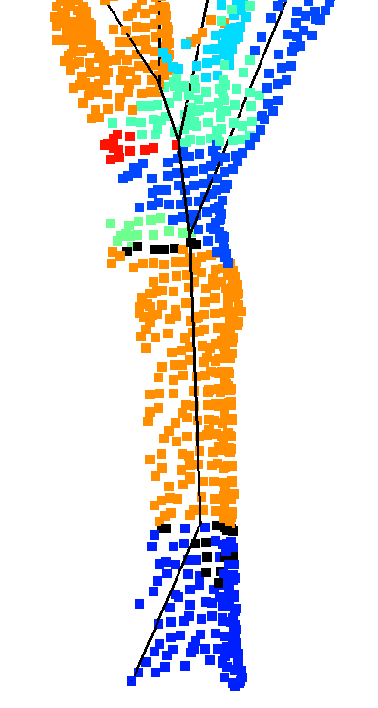
3.3 Branch fitting
Fit cylinders to approximate the branch geometry
Assign each branch with corresponding points

Slide 30
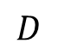
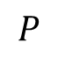
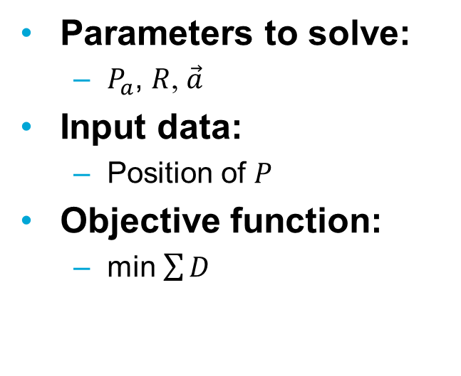
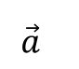
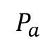
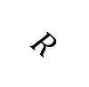
3.3 Branch fitting
Fit cylinders to approximate the branch geometry
Non-linear least squares problem (Levenberg–Marquardt algorithm)
Parameters to solve:
$P_{a}$, $R$, $\vec{a}$
Input data:
Position of $P$
Objective function:
min $\sum{D}$
$$\vec{a}$$
$$P$$
$$P_{a}$$
$$D$$
$$R$$
Points

Slide 31
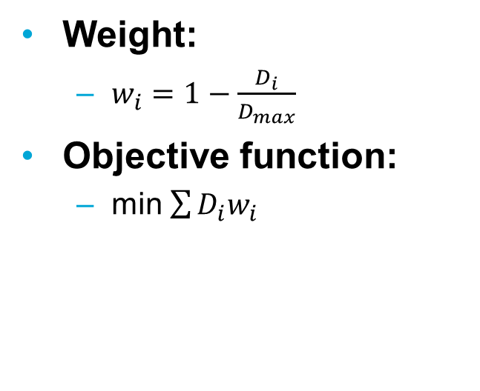
3.3 Branch fitting
Fit cylinders to approximate the branch geometry
2nd iteration: Weighted non-linear least squares
Weight:
$w_{i}=1−\frac{D_{i}}{D_{max}}$
Objective function:
min $\sum{D_{i}w_{i}}$
$$\vec{a}$$
$$P$$
$$P_{a}$$
$$D$$
$$R$$
Points

Slide 32
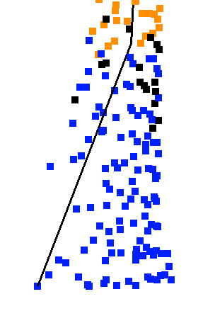
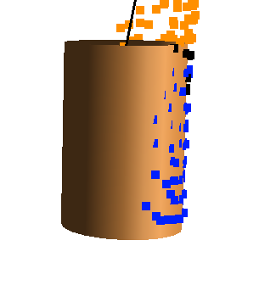
3.3 Branch fitting
Fit cylinders to approximate the branch geometry
Fit a cylinder first for the main trunk

Slide 33
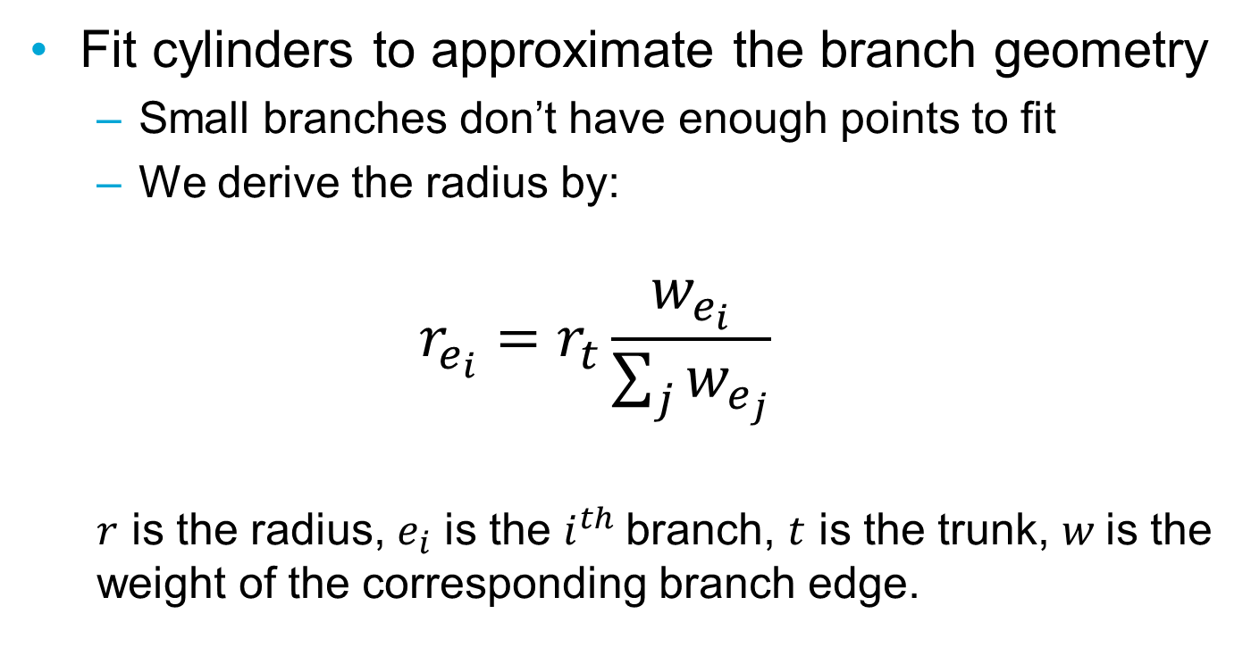
3.3 Branch fitting
Fit cylinders to approximate the branch geometry
Small branches don’t have enough points to fit
We derive the radius by:
$$r_{e_{i}}=r_{t}\frac{w_{e_{i}}}{\sum_{j}{w_{e_{j}}}}$$
$r$ is the radius, $e_{i}$ is the $i^{th}$branch, $t$ is the trunk, $w$is the weight of the corresponding branch edge.

Slide 34
3.3 Branch fitting
Fit cylinders to approximate the branch geometry

Slide 35
3. Methodology Overview
Add realism
Point cloud
Skeleton Initialization
Skeleton Simplification
Branch Fitting
Fine Model

Slide 36
3.4 Adding realism
Add leaves and texture to the tree model
Reconstructing leaves almost impossible
Randomly grow leaves on top of branches

Slide 37
4. Experiment Results

Slide 38
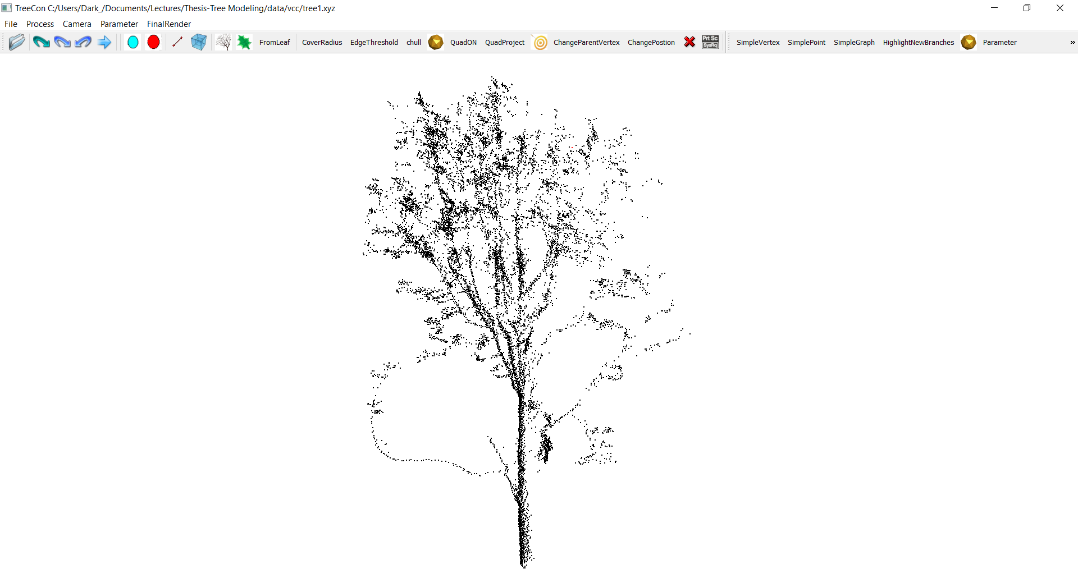
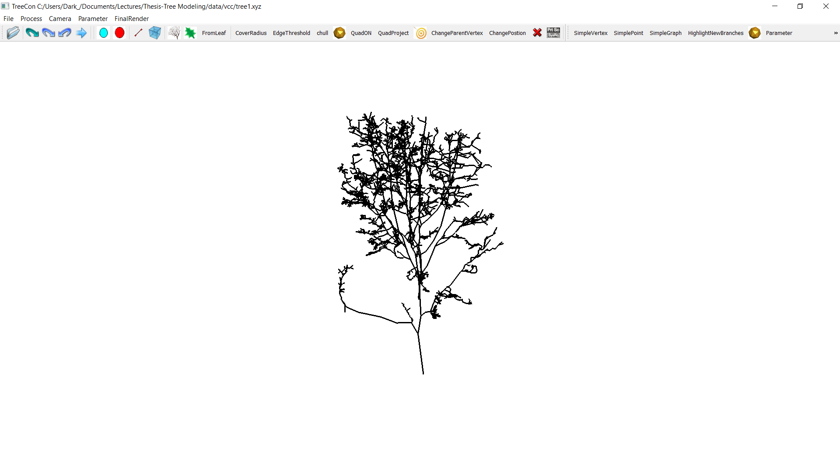
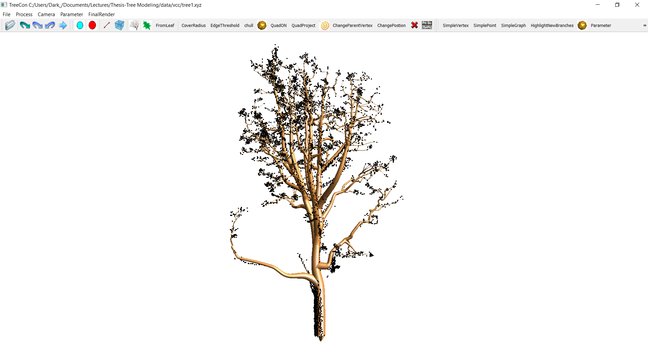
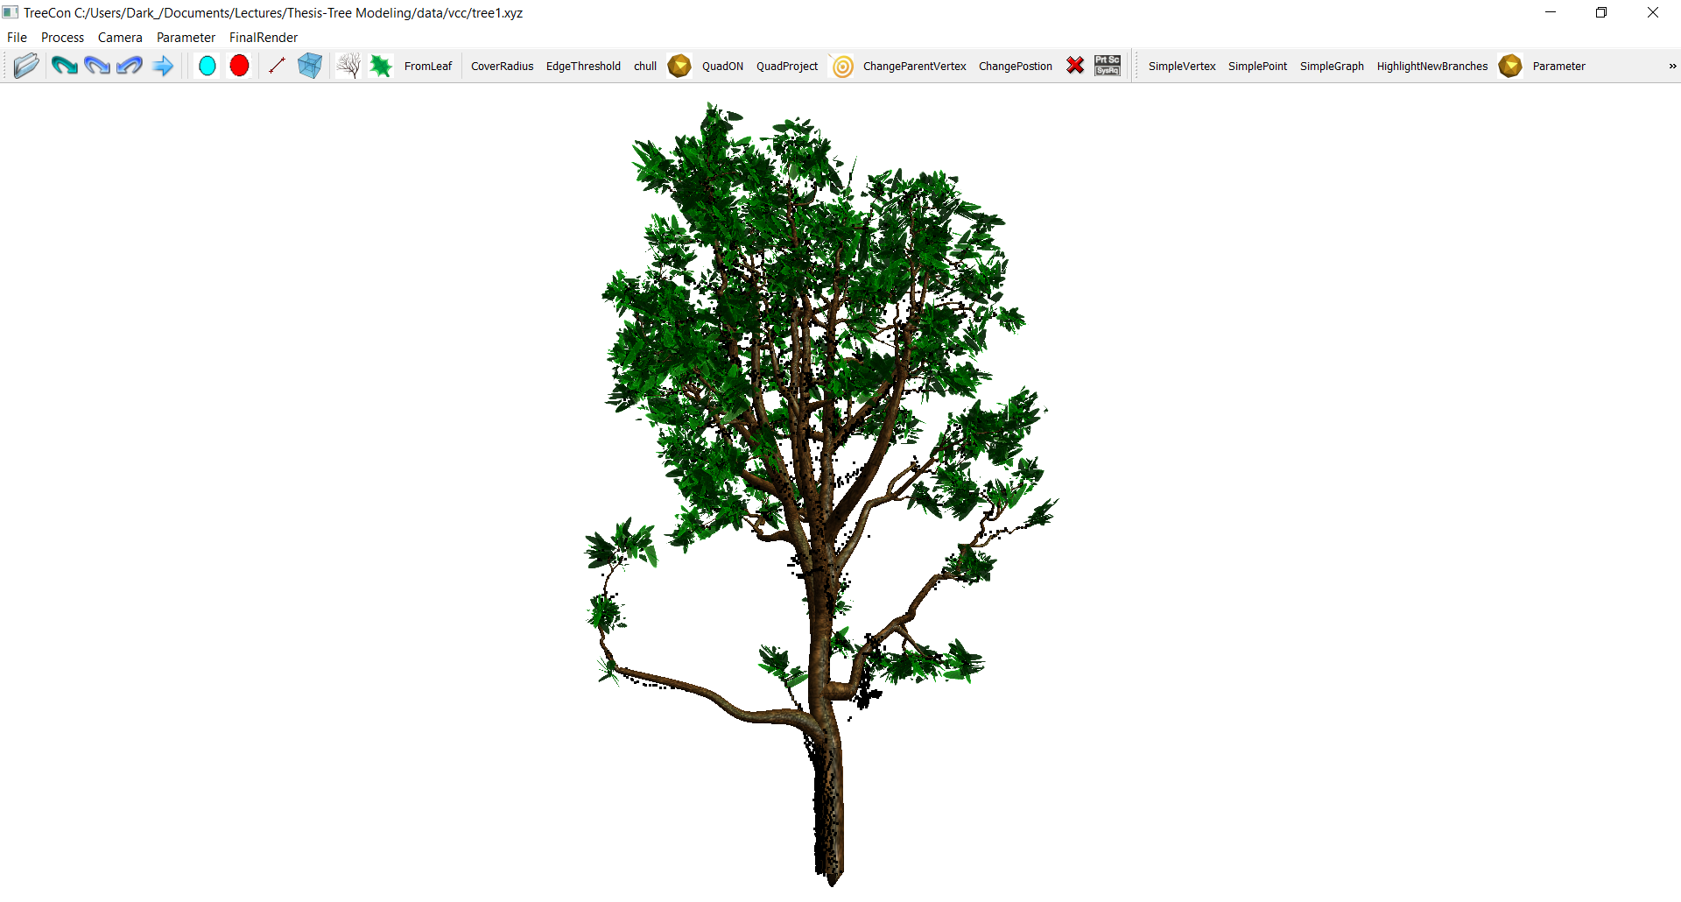
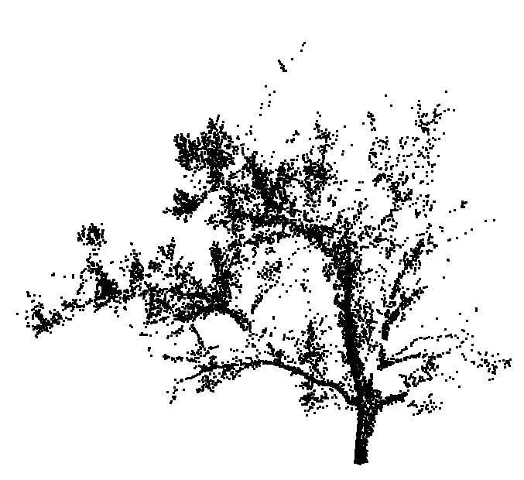



4.1 Results: different tree types
Input points
skeleton
branches
fine model

Slide 39








4.1 Results: different data sources
Input points
skeleton
branches
fine model

Slide 40

4.2 Evaluation: geometrical accuracy
Measure the distance from points to the model
 | Tree No.1 | Tree No.2 | Tree No.3
Height | 5.61m | 10.05m | 10.61m
Mean distance | 2.76cm | 10.04cm | 6.25cm
Standard deviation | 0.02 | 0.08 | 0.06

Slide 41



4.2 Evaluation: geometrical accuracy
Error visualization
19cm
0cm

Slide 42




4.3 Comparisons
Improve topological fidelity
Livny’s method
Our method

Slide 43




4.3 Comparisons
Improve geometrical accuracy
Livny’s method
Our method

Slide 44
5. Conclusions & Future Work

Slide 45
5.1 Conclusions
Fully-automatic
Widely applicable to various trees
Able to achieve high modelling quality from static scanning data and mobile scanning data
Able to generate plausible results from airborne scanning data

Slide 46

5.2 Applications
Compute tree height & trunk thickness
H
$$r$$

Slide 47


5.2 Applications
Estimate wood volume, biomass..

Slide 48






5.2 Applications
Enhance realism in urban scenes

Slide 49
5.3 Limitations
Data-driven mainly
Not involving the natural growing rules of tree branches

Slide 50






5.4 Future Work
Individual tree
A set of trees
Cylinder fitting
Free form surface fitting
Point cloud only
Points with Images

Slide 51
Thanks! Any Questions?

